Slide 1
COMPETITIVE CODING

Slide 2
FUNCTIONS
A function in C++ refers to a group of statements that takes input, processes it, and returns an output. The idea behind a function is to combine common tasks that are done repeatedly. If you have different inputs, you will not write the same code again. You will simply call the function with a different set of data called parameters.
Each function puts related code together. This makes it easier for programmers to understand code.
Functions facilitate code reuse. You can call the same function to perform a task at different sections of the program or even outside the program.

Slide 3
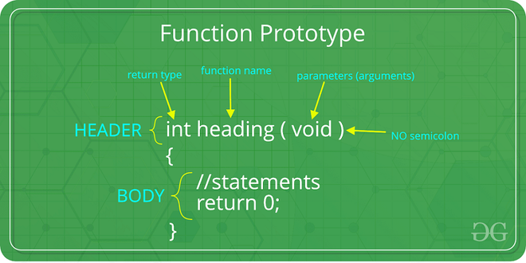

Slide 4
POINTERS
Pointers are symbolic representations of addresses.
They enable programs to simulate call by reference as well as to create and manipulate dynamic data structures.
Iterating over elements in arrays or other data structures is one of the main use of pointers.
The address of the variable you’re working with is assigned to the pointer variable that points to the same data type (such as an int or string).

Slide 5
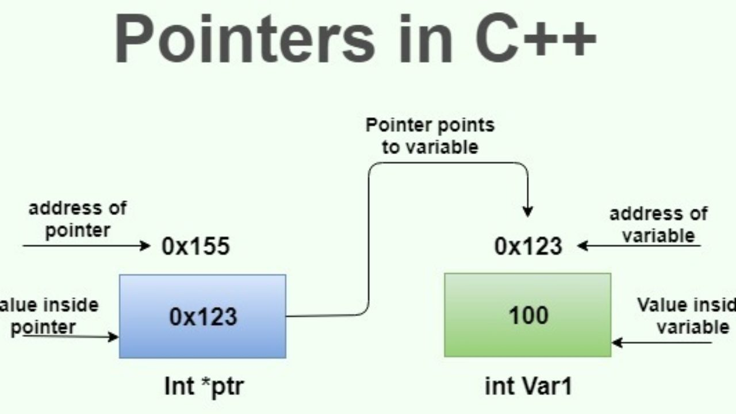

Slide 6
OOPS
OOPs, or Object-oriented programming is an approach or a programming pattern where the programs are structured around objects rather than functions and logic.
It makes the data partitioned into two memory areas, i.e., data and functions, and helps make the code flexible and modular.
Object-oriented programming mainly focuses on objects that are required to be manipulated.
In OOPs, it can represent data as objects that have attributes and functions.

Slide 7
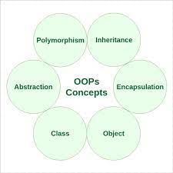

Slide 8
DATA STRUCTURE & ALGORITHMS
A data structure is defined as a particular way of storing and organizing data in our devices to use the data efficiently and effectively. The main idea behind using data structures is to minimize the time and space complexities. An efficient data structure takes minimum memory space and requires minimum time to execute the data.
Algorithm is defined as a process or set of well-defined instructions that are typically used to solve a particular group of problems or perform a specific type of calculation. To explain in simpler terms, it is a set of operations performed in a step-by-step manner to execute a task.

Slide 9
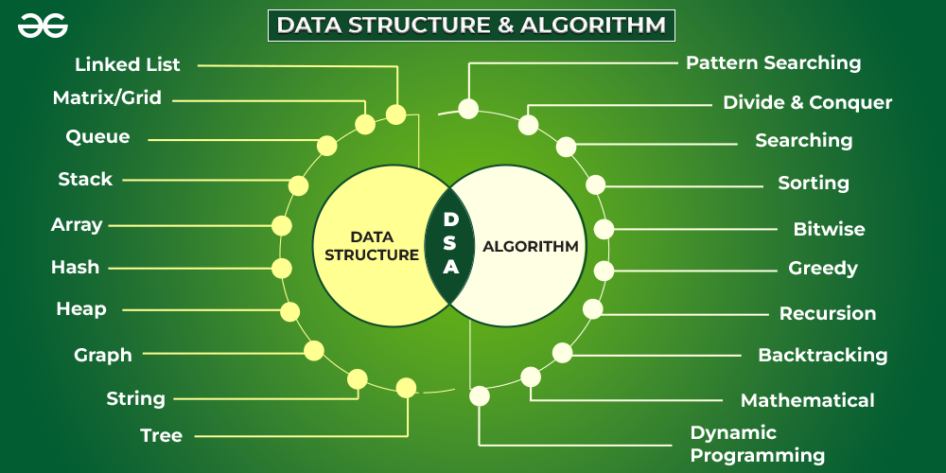

Slide 10
Analyze and design algorithms
Worst-case − The maximum number of steps taken on any instance of size
Best-case − The minimum number of steps taken on any instance of size
Average case − An average number of steps taken on any instance of size

Slide 11
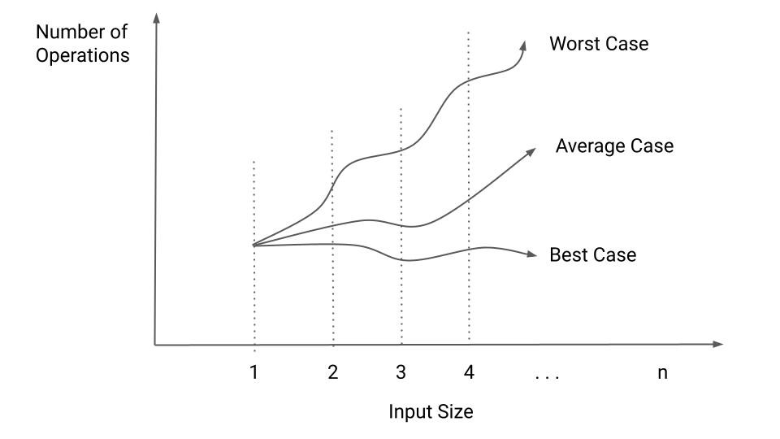

Slide 12
ARRAY
The array is that type of structure that stores homogeneous elements at memory locations which are contiguous.
The same types of objects are stored sequentially in an array. The main idea of an array is that multiple data of the same type can be stored together.
Any element in the array can be accessed or modified and the elements stored are indexed to identify their locations.

Slide 13
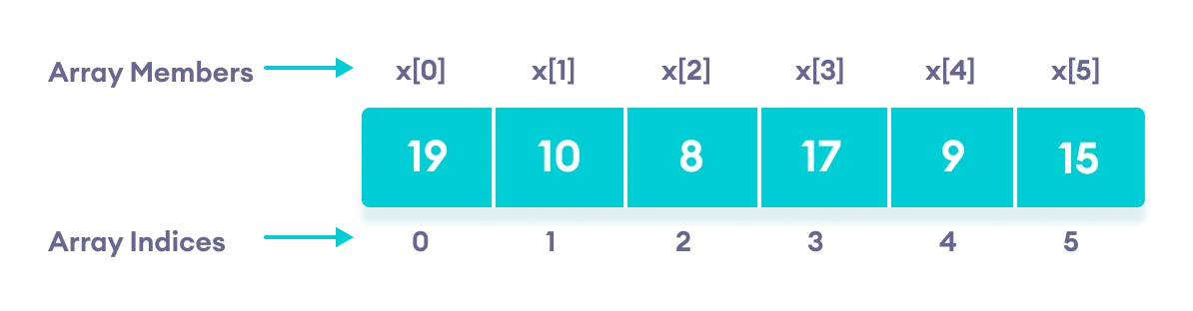

Slide 14
LINKED LIST
The linked list is that type of data structure where separate objects are stored sequentially.
Every object stored in the data structure will have the data and a reference to the next object.
The last node of the linked list has a reference to null. The first element of the linked list is known as the head of the list.
Getting to an element in a linked list is a slower process compared to the arrays as the indexing in an array helps in locating the element.

Slide 15
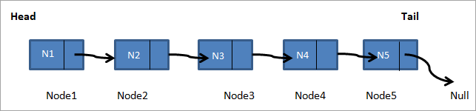

Slide 16
STACK
The stack is another type of structure where the elements stored in the data structure follow the rule of LIFO (last in, first out)
Two types of operations are associated with a stack i.e. push and pop.
Push is used when an element has to be added to the collection and pop is used when the last element has to be removed from the collection.
Extraction can be carried out for only the last added element.

Slide 17
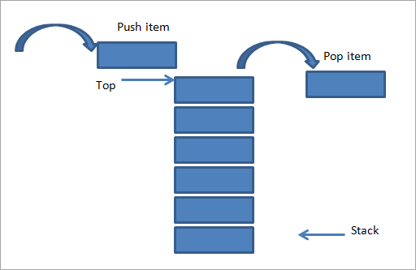

Slide 18
QUEUE
Queue is the type of data structure where the elements to be stored follow the rule of First In First Out (FIFO).
The particular order is followed for performing the required operations over the elements.
The difference of a queue from that of a stack lies in the removal of an element, where the most recently added object is removed first in a stack.
Whereas, in the case of a queue, the element that was added first is removed first. Both the end of the data structure is used for the insertion and the removal of data.
The two main operations governing the structure of the queue are enqueue, and dequeue. Enqueue refers to the process where inserting an element is allowed to the collection of data and dequeue refers to the process where removal of elements is allowed, which is the first element in the queue in this case.

Slide 19
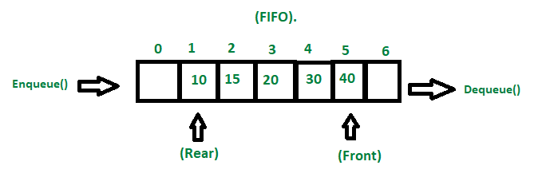

Slide 20

THANKS!
Shivay Bhandari
URN - 1905398
CRN - 1921142

